Slide 1
Recurrent Neural Network

Slide 2
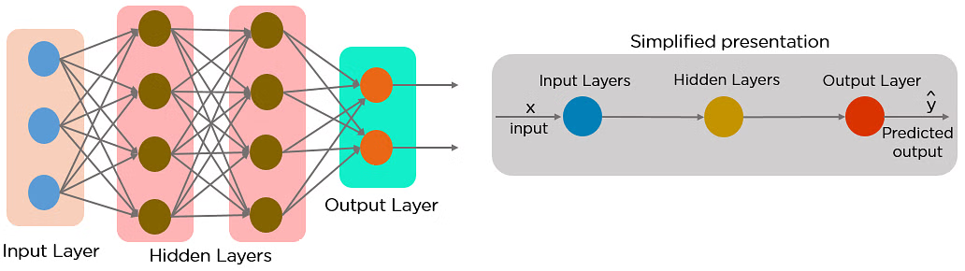
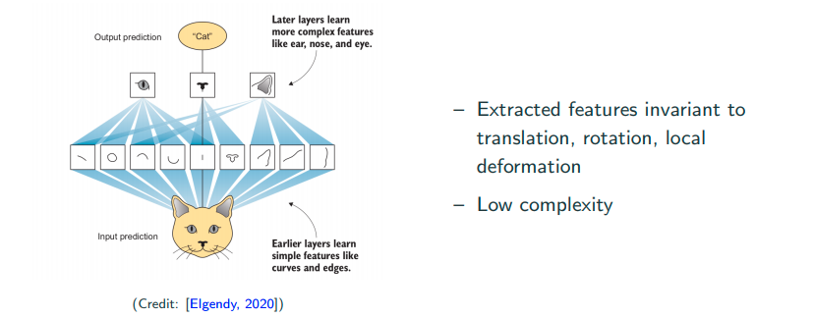
Why Recurrent Neural Networks?
RNN were created because there were a few issues in the feed-forward neural network:
Cannot handle sequential data
Considers only the current input
Cannot memorize previous inputs

Slide 3
RNN
A recurrent neural network (RNN) is a type of artificial neural network which uses sequential data or time series data.
Language translation,
Natural language processing (NLP),
Speech recognition,
Image captioning
They are incorporated into popular applications such as voice search, and Google Translate.

Slide 4
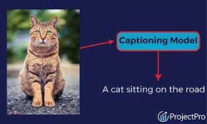
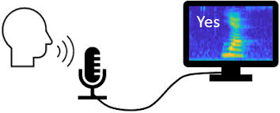
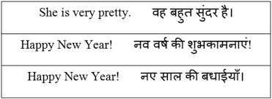
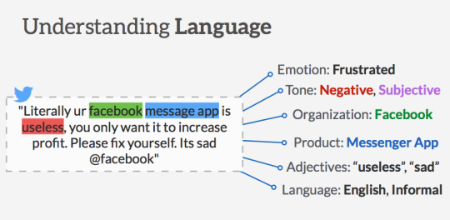
Image captioning
Speech to text conversion
Language translation
NLP

Slide 5
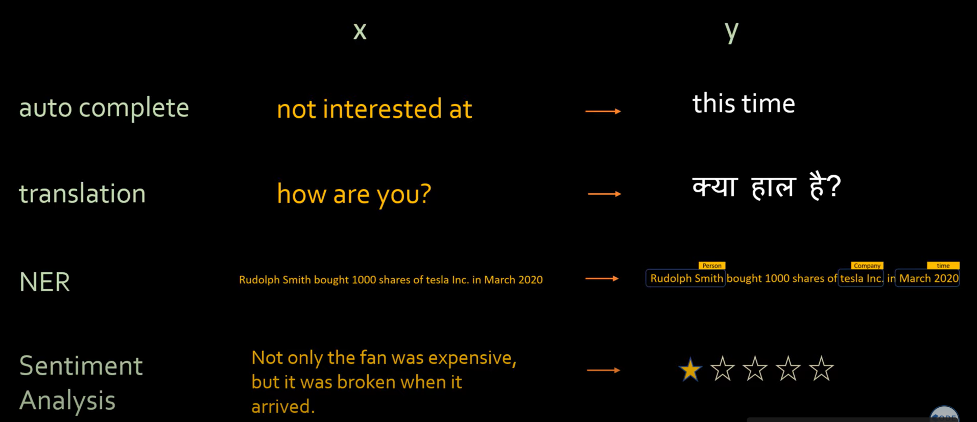

Slide 6
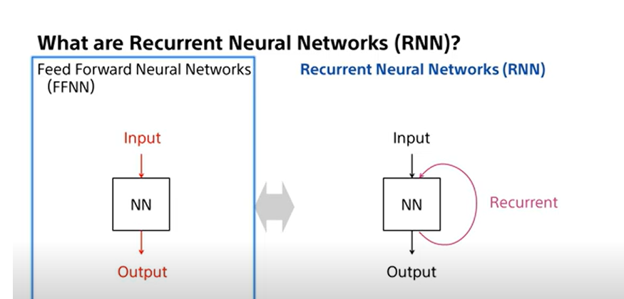
Feed Back link in RNN

Slide 7
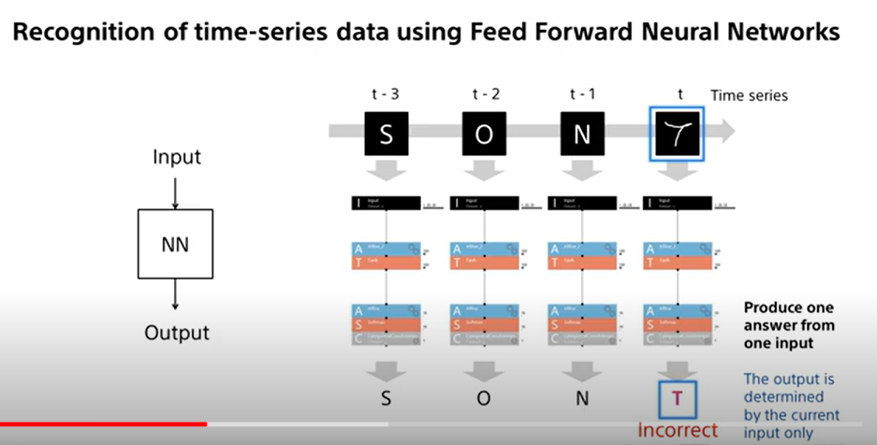

Slide 8
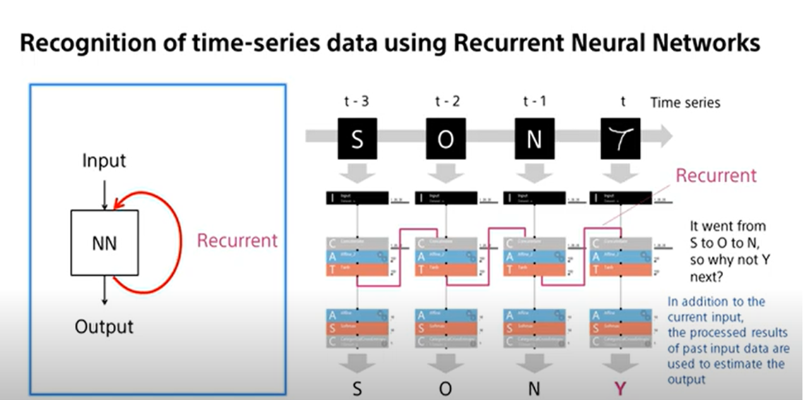

Slide 9
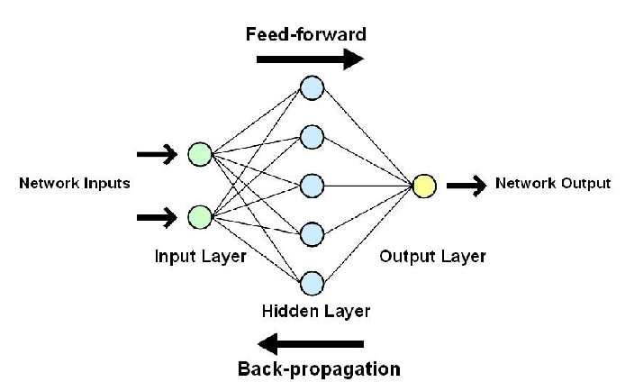
ANNs send data in one direction, passing it through multiple input nodes until it reaches the output node.
Error is there, we back propagate.
https://www.youtube.com/watch?v=yqXxXIwHC0c
https://www.youtube.com/watch?v=jPPWc0y-08Q

Slide 10
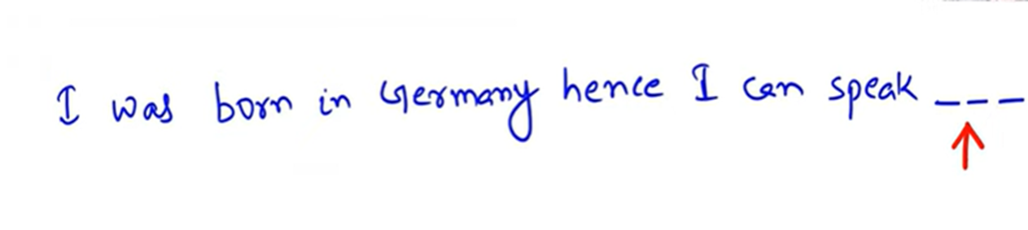
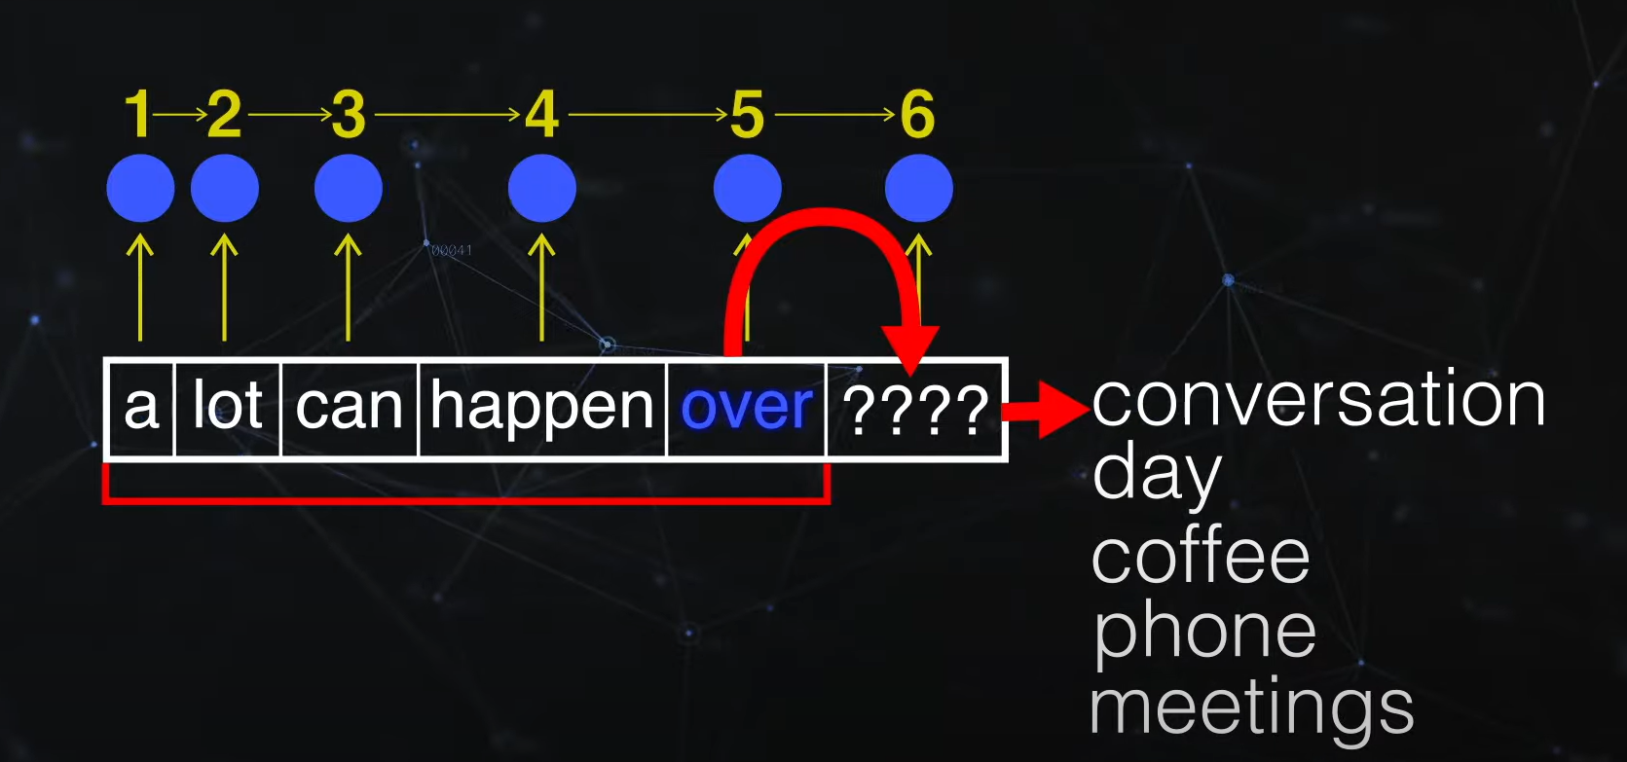
RNN has memory
https://www.simplilearn.com/tutorials/deep-learning-tutorial/rnn

Slide 11
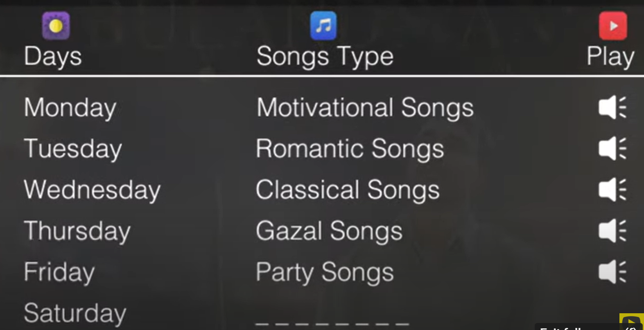

Slide 12
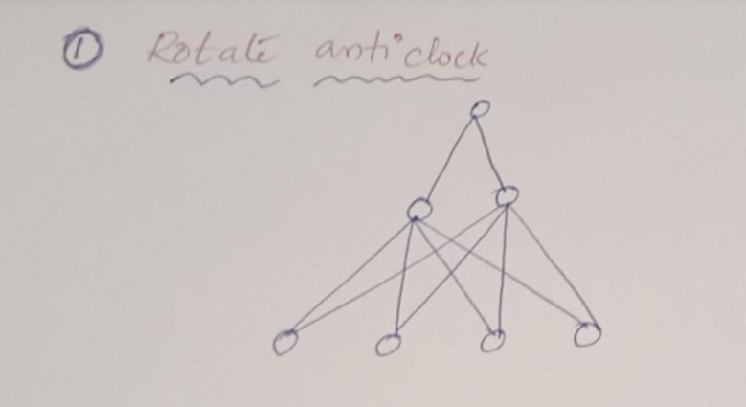
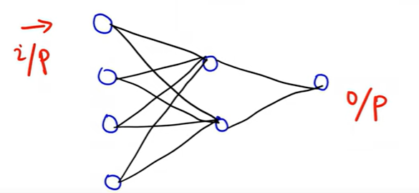
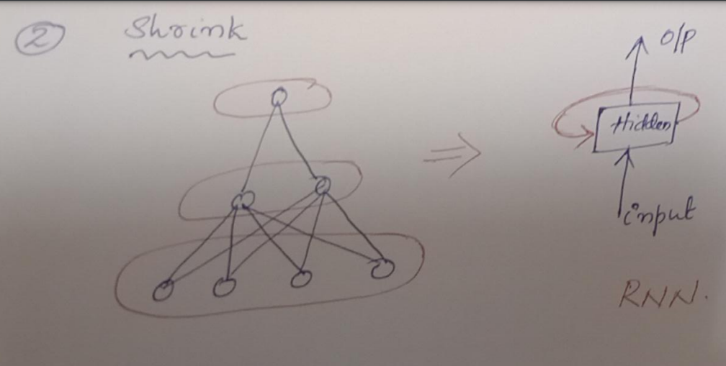
ANN
ANN to RNN

Slide 13
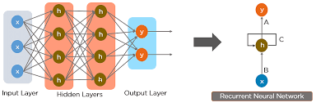

Slide 14
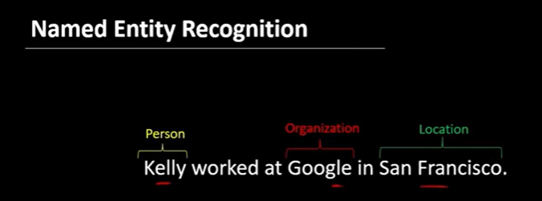
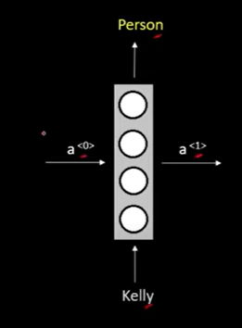
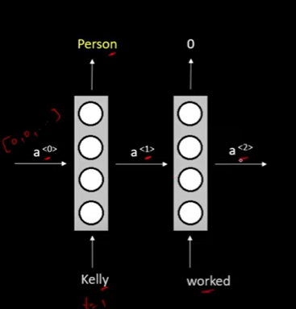
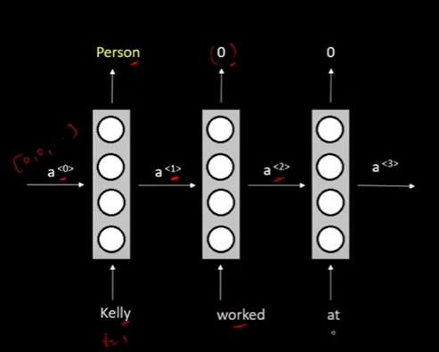
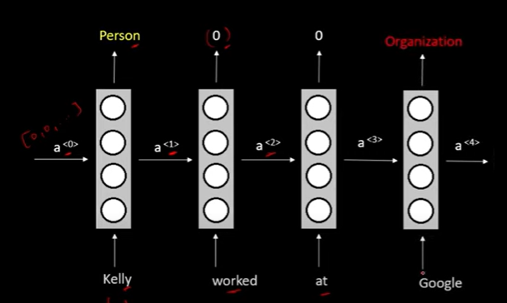
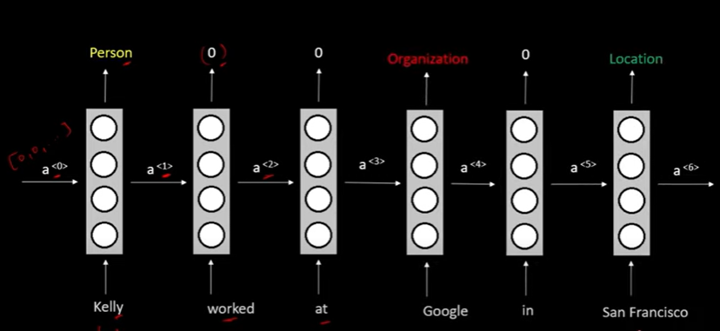

Slide 15
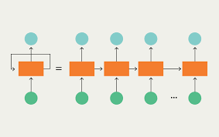

Slide 16
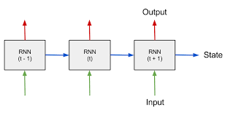
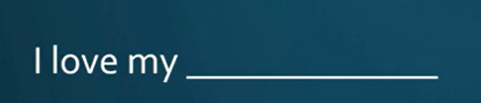
RNN
RNN the output from the previous step is fed as input to the current step.
PET/COUNTRY
I
LOVE
MY

Slide 17
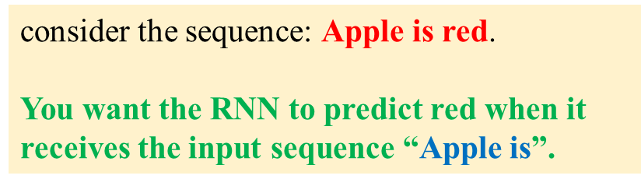
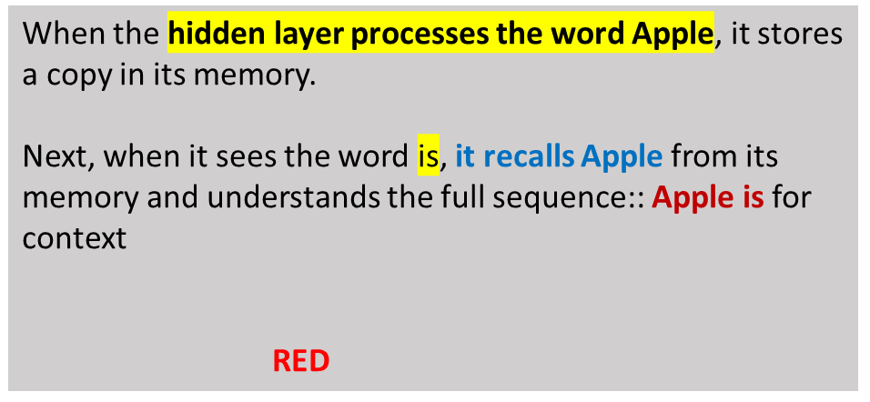

Slide 18
RNN
RNNs are called recurrent because they perform the same task for every element of a sequence, with the output being depended on the previous computations.
Another way to think about RNNs is that they have a “memory” which captures information about what has been calculated so far.

Slide 19
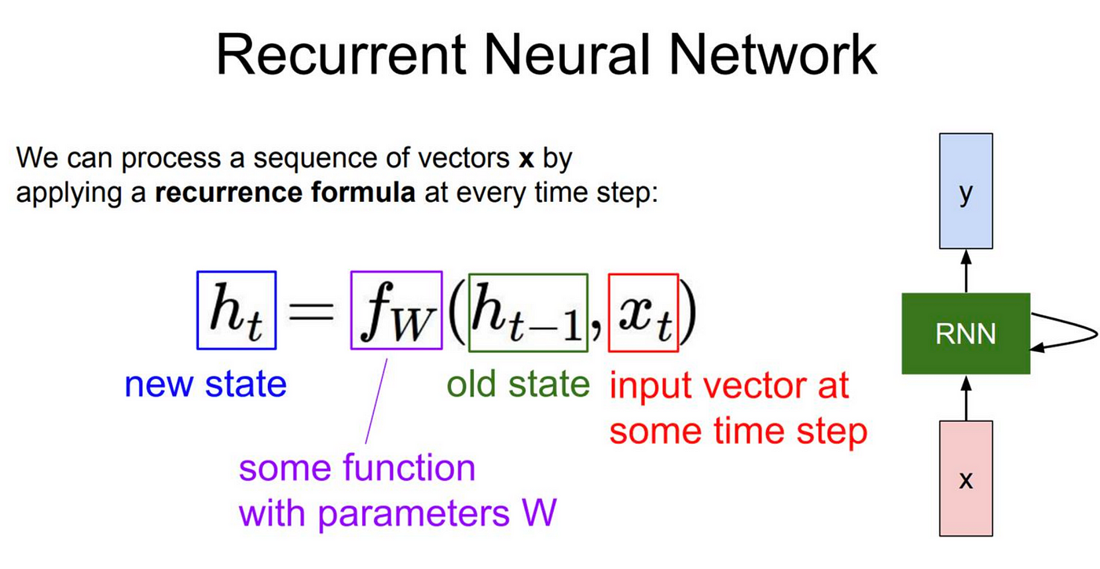
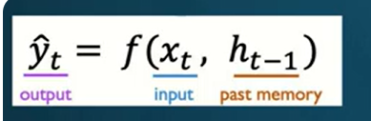

Slide 20
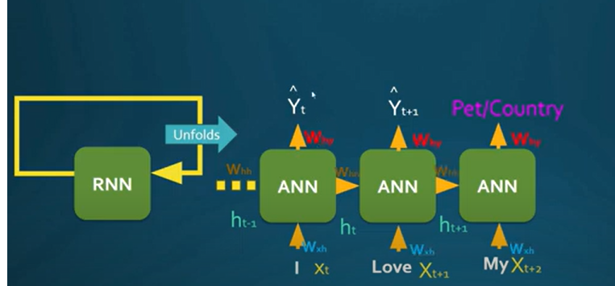
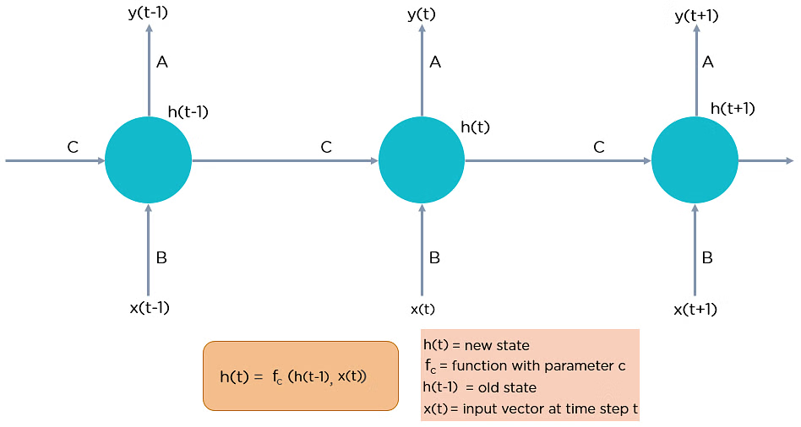

Slide 21
Types of RNN
There are four types of RNNs based on the number of inputs and outputs in the network.
One to Many
Many to One
Many to Many
One to one

Slide 22
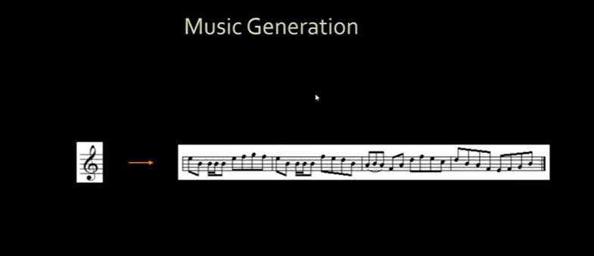

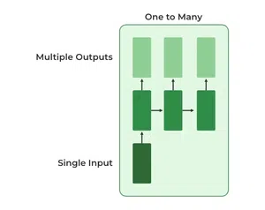
One To Many
In this type of RNN, there is one input and many outputs associated with it. One of the most used examples of this network is Image captioning where given an image we predict a sentence having Multiple words.

Slide 23
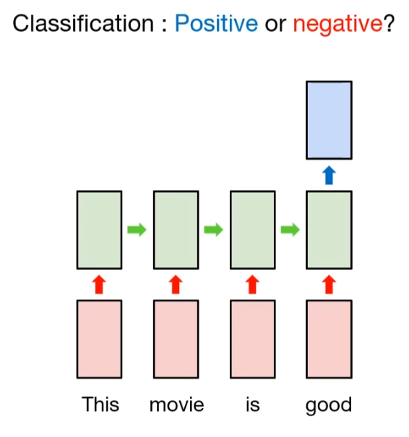
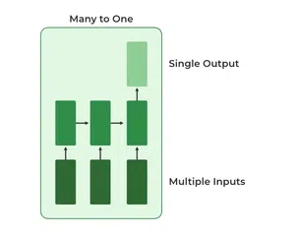
Many to One
In this type of network, Many inputs are fed to the network at several states of the network generating only one output. This type of network is used in the problems like sentimental analysis. Where we give multiple words as input and predict only the sentiment of the sentence as output.

Slide 24
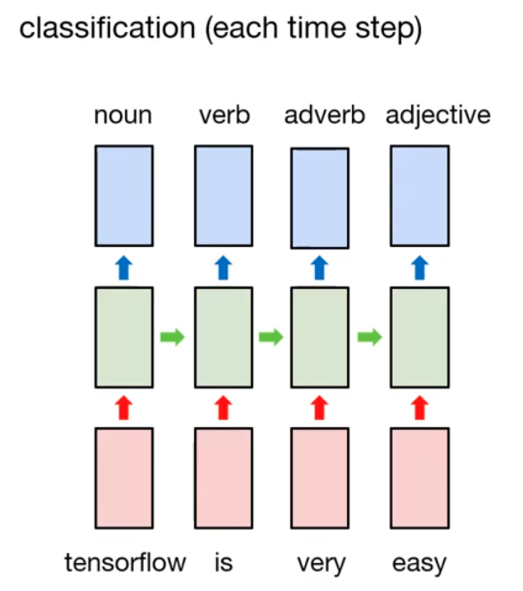
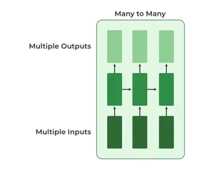

Many to Many
In this type of neural network, there are multiple inputs and multiple outputs corresponding to a problem. One Example of this Problem will be language translation. In language translation, we provide multiple words from one language as input and predict multiple words from the second language as output.

Slide 25
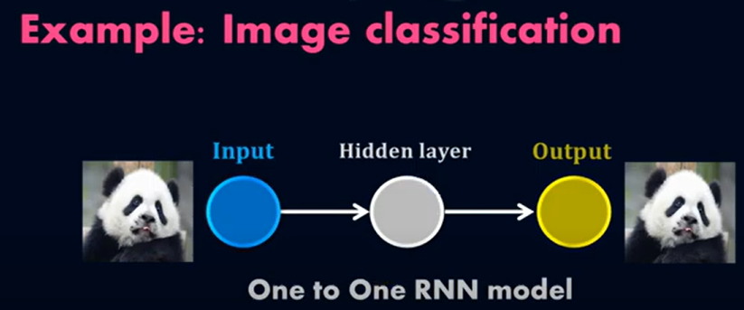
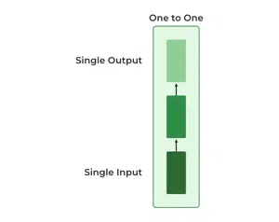
One to One
This type of RNN behaves the same as any simple Neural network it is also known as Vanilla Neural Network. In this Neural network, there is only one input and one output.
This is also called Plain Neural networks. It deals with a fixed size of the input to the fixed size of output, where they are independent of previous information/output.

Slide 26
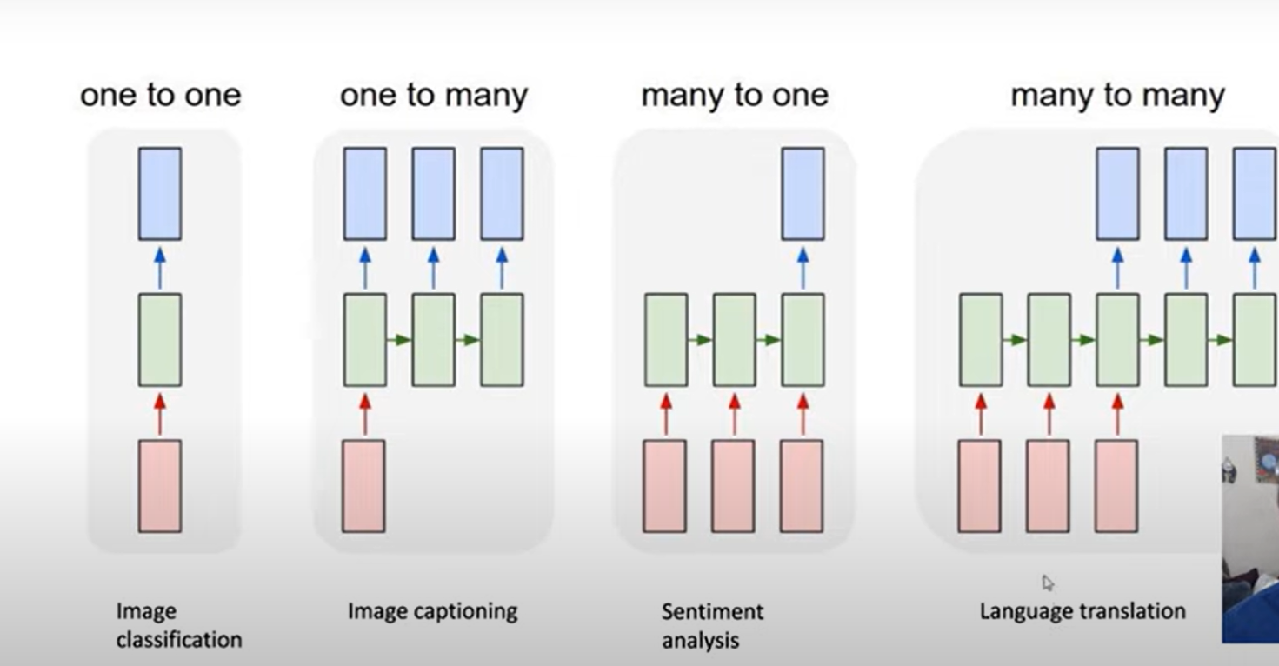

Slide 27
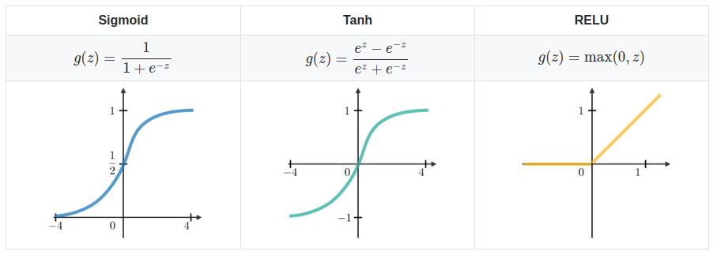
Activation functions used

Slide 28
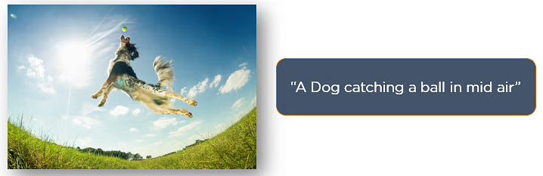
Applications of Recurrent Neural Networks
Image Captioning

Slide 29
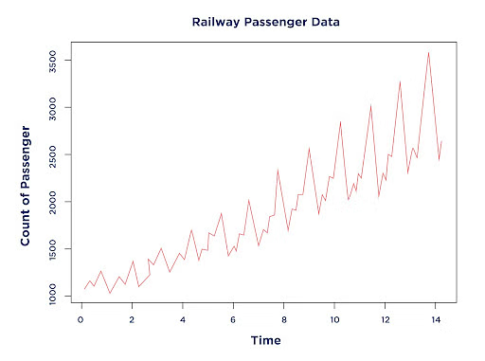
Time Series Analysis
Rainfall measurements
Automated stock trading
Industry forecast
Temperature readings
Sales forecasting

Slide 30
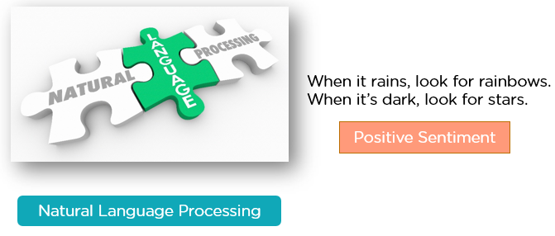
Natural Language Processing
Text mining and Sentiment analysis can be carried out using an RNN for Natural Language Processing (NLP).

Slide 31

Machine Translation
Given an input in one language, RNNs can be used to translate the input into different languages as output.

Slide 32
Advantages and disadvantages of RNN
Advantages of RNNs:
Handle sequential data effectively, including text, speech, and time series.
Process inputs of any length, unlike feedforward neural networks.
Share weights across time steps, enhancing training efficiency.
Disadvantages of RNNs:
Prone to vanishing and exploding gradient problems, hindering learning.
Training can be challenging, especially for long sequences.
Computationally slower than other neural network architectures.

Slide 33
You Tube video
https://www.youtube.com/watch?v=hf2-9Y_-uQ0

